Slide 1
Digital Marketing Essentials
Part 2: Marketing Basics and Planning

Slide 2
Learning Objectives
At the end of this session, you will be able to
Define digital marketing and outline the steps in the marketing process.
Explain the key building-block concepts that are essential to any strategy
Explain the questions that need to be asked when designing a digital marketing strategy.

Slide 3
Digital Marketing
Part II

Slide 4

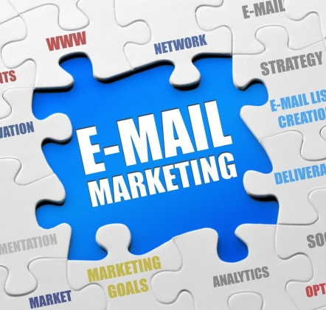

What is Digital Marketing?
If marketing creates and satisfies demand, digital marketing drives the creation of demand using the power of Internet, and satisfy the demand in new and innovative ways.
Digital marketing is marketing that makes use of electronic devices (computers) such as personal computers, smartphones, cellphones, tablets TV and game consoles to engage with stakeholders.
Source: http://en.wikipedia.org/wiki/Digital_marketing

Slide 5
Activity 2
Is digital marketing a totally new way of marketing where traditional marketing concepts cannot be applied to digital marketing?

Slide 6
What is Digital Marketing?
The complete scope of marketing is practiced on the Internet – products and services are positioned and promoted, purchased, distributed and serviced.
It is not a new marketing channel; instead, it creates a new paradigm for the way in which consumers connect with brands and with each other.
Marketing on the Internet does not mean throwing out the rule book on marketing and business principles. Instead, the Internet provides a new environment in which to build on these.

Slide 7
Activity 3
The business name (brand name) and the brand, are they the same?

Slide 8
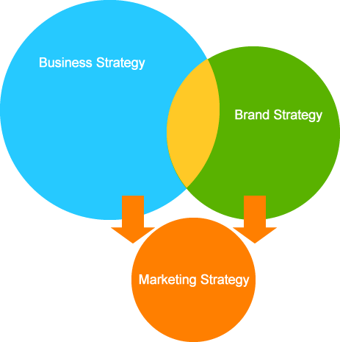
Understanding Marketing Strategy
Understand your Business and Brand Strategy
Business Strategy:
‘What is the business challenge we are facing that prevents us from making more revenue?’ or, ‘What business objective should we strive for in order to increase the money in the bank?’
2
1
Brand Strategy:
How aware are people of the brand? Does it hold positive associations and perceived value? How loyal are people to the brand?
3
Marketing Strategy:
Marketing strategy is to address a business or brand challenge or objective that has been revealed.

Slide 9


Marketing Strategy
how it is going to add value to the category and differentiate itself from competitors
whether their product is a domestic or international service
whether its target market would be budget travelers or international and business travelers
whether the channel would be through primary airports or smaller, more cost-effective airports
Environment
Business
Customers
Competitors

Slide 10
Marketing Strategy
Understanding the Environment
Overall context in which business functions.
Analysis of business and brand environment typically consider PESTLE influences to identify a clear set of consideration or issues pertinent to the marketing strategy.
Political
Economical
Social
Technological
Legal
Environmental

Slide 11
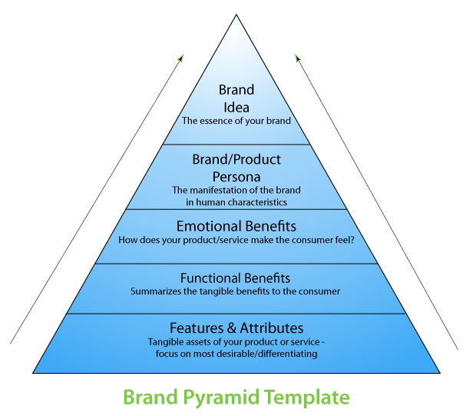
Marketing Strategy
Understanding the Business and Brand
Crucial consideration is the brand itself.
Determine your brand or product’s USP (unique selling proposition)
A USP is the one characteristic that makes your product or service better than the competition’s – what unique value does it have? Does it solve a problem that no other product does?

Slide 12
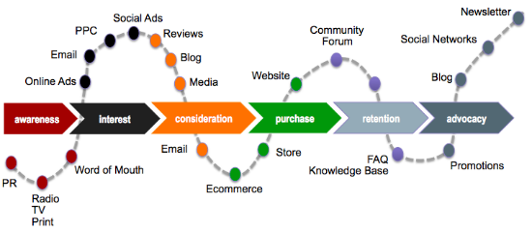
Marketing Strategy
Understanding the Customers
Conduce market research – finding why people like and attract with your brand.
Capitalize on this in your marketing content.
Understand the consumer journey (buying funnel) so that you can prepare the right marketing message at the right stage of their journey.

Slide 13
Marketing Strategy
Understanding the Competitors
Who else is marketing to your potential customers? What they offer?
How can you challenge or learn from them?
what you can learn from and do better
what they're doing worse than you
what they're doing the same as you
When considering competition, it’s also worthwhile looking at potential replacements for your product.

Slide 14
Marketing Strategy
Once you have a clear sense of what the business challenge or objective is, and you have defined how your marketing strategy will work towards fulfilling it, you can start thinking about your digital marketing strategy.

Slide 15
Digital Marketing Strategy
It builds on and adapts the principles of traditional marketing
Constantly iterating and evolving
Instantaneous feedback and data gathering allow marketers to optimize and improve their efforts
Greater opportunities for interaction and customer engagement
Highly empirical – almost everything can be measured: from behaviors, to actions and action paths, to results

Slide 16
Building Blocks of Marketing Strategy
Porter’s Five Forces
The Four P’s (Marketing Mix)
SWOT Analysis

Slide 17
Building Blocks of Marketing Strategy
Porter’s Five Forces
Tool to determine competitive intensity and attractiveness of a market
Competitive Rivalry Within The Industry
Bargaining Power Of Customers
Threat Of New Entrants
Bargaining Power Of Suppliers
Threat Of Substitute Products

Slide 18
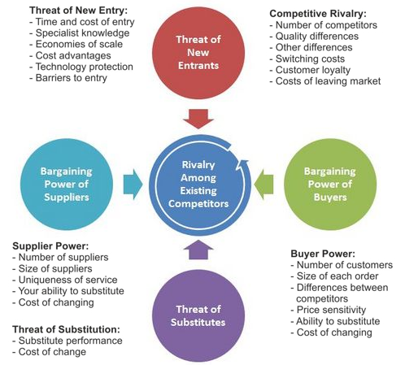
Building Blocks of Marketing Strategy
Porter’s Five Forces

Slide 19
Building Blocks of Marketing Strategy
The Four P’s (Marketing Mix)
Product
Price
Place
Promotion
A new P: People
The powerful human element that the digitally connected world permits: personalization, peer-to-peer sharing, communities, and consumer- centric organizations that allow people to participate in the brand story.

Slide 20
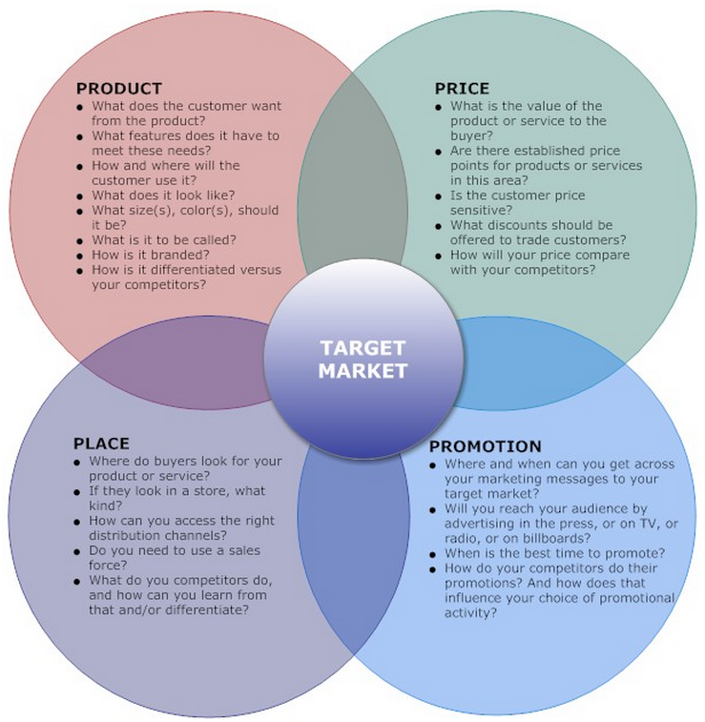
Building Blocks of Marketing Strategy
The Four P’s

Slide 21
Building Blocks of Marketing Strategy
SWOT Analysis
Strengths, Weaknesses, Opportunities and Threats
It analysis is an ideal way to understand your business and your market.
It is part of a situational analysis and identifies the key issues that direct the marketing strategy.

Slide 22
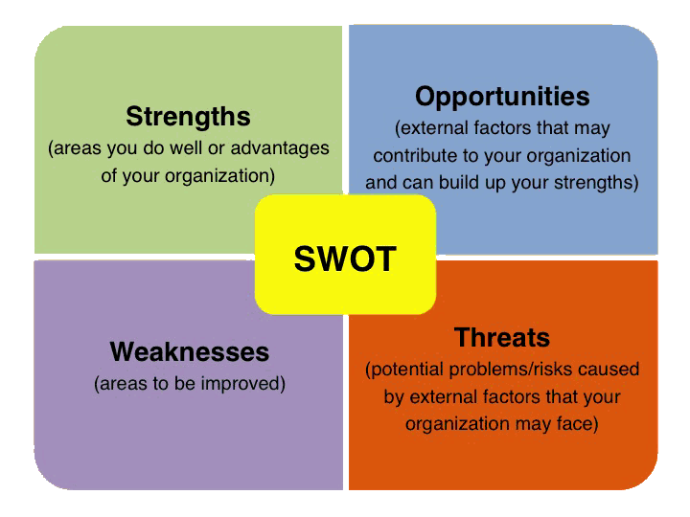
Building Blocks of Marketing Strategy
SWOT Analysis

Slide 23
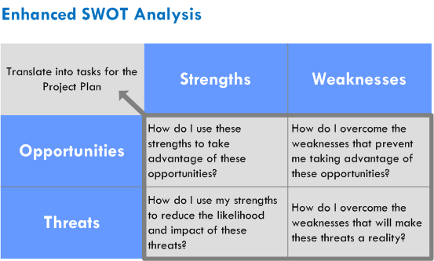
Building Blocks of Marketing Strategy
SWOT Analysis

Slide 24
Crafting a digital marketing strategy
Part III

Slide 25
Steps in Developing Digital Marketing Strategy
Examine the context
Examine the value exchange
Setting objectives
Choose the tactics and evaluation
Ongoing optimization

Slide 26
Steps in Developing Digital Marketing Strategy
Step 1 - The Context
The first step in crafting a successful strategy is to examine the context of the organisation and the various stakeholders.
What is the context in which you are operating (PESTLE factors) and how is this likely to change in the future?
Who are you, why does your brand matter and what makes your brand useful and valuable?
Who are your customers, and what needs, wants and desires do they have?
Who are your competitors? These may extend beyond organizations that compete with you on the basis of price and product and could also be competition in the form of abstracts such as time and mindshare.

Slide 27
Steps in Developing Digital Marketing Strategy
Step 2 - The Value Exchange
Examine your value proposition or promise
what unique value your organisation can add to that market
Important to identify the supporting value-adds to the brand promise that are unique to the digital landscape
What extras (through Internet, beyond the basic product or service, do you offer to customers?
The Internet offers many channels for value creation. However, the definition of what is ‘valuable’ depends largely on the target audience, so it is crucial to research your users and gather insights into what they want and need.

Slide 28
Steps in Developing Digital Marketing Strategy
Step 2 - The Value Exchange
Content marketing is the process of conceptualizing and creating this sort of content – examples of value-based content include a DIY gardening video for a hardware brand, a research paper for a business analyst, or a funny infographic for a marketing company.

Slide 29
Activity 4
Suggest some value-based content for following businesses:
Travel and tours company
English language training center
Food steamer brand
Business selling pianos and synthesizers
Herbal medicine practitioner

Slide 30
Steps in Developing Digital Marketing Strategy
Step 3 - Objectives
Four key aspects to be considered:
Objectives
Tactics
Key Performance Indicators (KPIs)
Targets

Slide 31
Steps in Developing Digital Marketing Strategy
Step 3 - Objectives
Objectives
What are you trying to achieve?
How will you know if you are successful?
Objectives need to be SMART:
Specific – the objective must be clear and detail rather than vague and general.
Measurable – the objective must be measurable so that you can gauge whether you are attaining desired outcome.
Attainable – The objective must be something that is possible for your brand to achieve, based on available resources.
Realistic – the objective must also be sensible and based on data and trends; don’t exaggerate or overestimate what can be achieved.
Time-bound – finally, the objective must be linked to a specific timeframe.

Slide 32
Steps in Developing Digital Marketing Strategy
Step 3 - Objectives
Tactics
Specific tools or approaches you will use to meet your objectives
for example, a retention-based email newsletter, a Facebook page, or a CRM implementation.
You may have multiple tactics working together to try to achieve the same objective.
Tactics may change (and often should), but the objective should remain your focus.

Slide 33
Steps in Developing Digital Marketing Strategy
Step 3 - Objectives
Key Performance Indicators (KPIs)
KPIs are the specific metrics or pieces of data that you will look at to determine whether your tactics are performing well and meeting your objectives.
For example, a gardener may look at the growth rate, color and general appearance of a plant to evaluate whether it is healthy.
marketer will look at a range of data points to determine whether a chosen tactic is delivering
KPIs are determined per tactic, with an eye on the overall objective.

Slide 34
Steps in Developing Digital Marketing Strategy
Step 3 - Objectives
Targets
The specific values that are set for your KPIs to reach within a specific time period.
Sportspeople need to reach targets to advance their careers – for example, come in the top ten to qualify for the final, or run 10km in under 27 minutes.
If you meet or exceed a target, you are succeeding; if you don’t reach it, you’re falling behind on your objectives and you need to reconsider your approach (or your target).

Slide 35
Steps in Developing Digital Marketing Strategy
Example
SMART Objective:
Increase sales through the e-commerce platform by 10% within the next six months.
Tactics:
Search advertising
Facebook brand page
KPIs per Tactics:
Search advertising – number of search referrals
Facebook brand page – number of comments and shares on campaign-specific posts
Targets per KPI:
Search advertising – 1000 search referrals after first month, with a 10% month-on-month increase after that
Facebook brand page – 50 comments and 10 shares on campaign-specific posts per week

Slide 36
Steps in Developing Digital Marketing Strategy
Step 4 – Tactics and Evaluation
Tactic | Outcome
SEO | Customer retention and acquisition
This is the practice of optimizing a website to rank higher on the search engine results pages for relevant search terms. SEO involves creating relevant, fresh and user-friendly content that search engines index and serve when people enter a search term that is relevant to your product or service. | SEO has a key role to play in acquisition, as it ensures your organization’s offering will appear in the search results, allowing you to reach potential customers. A site that is optimized for search engines is also a site that is clear, relevant and well designed. These elements ensure a great user experience, meaning that SEO also plays a role in retention.

Slide 37
Steps in Developing Digital Marketing Strategy
Step 4 – Tactics and Evaluation
Tactic | Outcome
Search advertising | Sales, customer retention and acquisition
In pay-per-click or search advertising, the advertiser pays only when someone clicks on their ad. The ads appear on search engine results pages. | The beauty of search advertising is that it is keyword based. This means an ad will come up in response to the search terms entered by the consumer. It therefore plays a role in sales, acquisition and retention. It allows the advertiser to reach people who are already in the buying cycle or are expressing interest in what they have to offer.

Slide 38
Steps in Developing Digital Marketing Strategy
Step 4 – Tactics and Evaluation
Online advertising | Branding and acquisition
Online advertising covers advertising in all areas of the Internet – ads in emails, ads on social networks and mobile devices, and display ads on normal websites. | The main objective of display advertising is to raise brand awareness online. It can also be more interactive and therefore less disruptive than traditional or static online advertising, as users can choose to engage with the ad or not. Online advertising can be targeted to physical locations, subject areas, past user behaviors, and much more.

Slide 39
Steps in Developing Digital Marketing Strategy
Step 4 – Tactics and Evaluation
Affiliate marketing | Sales and branding
Affiliate marketing is a system of reward whereby referrers are given a ‘finder’s fee’ for every referral they give. | Online affiliate marketing is widely used to promote e-commerce websites, with the referrers being rewarded for every visitor, subscriber or customer provided through their efforts. It is a useful tactic for brand building and acquisition.

Slide 40
Steps in Developing Digital Marketing Strategy
Step 4 – Tactics and Evaluation
Video marketing | Branding, customer retention and value creation
Video marketing involves creating video content. This can either be outright video advertising, or can be valuable, useful, content marketing. | Since it is so interactive and engaging, video marketing is excellent for capturing and retaining customer attention. Done correctly, it provides tangible value – in the form of information, entertainment or inspiration – and boosts a brand’s image in the eyes of the public.

Slide 41
Steps in Developing Digital Marketing Strategy
Step 4 – Tactics and Evaluation
Social media | Branding, value creation and participation
Social media, also known as consumer-generated media, is media (in the form of text, visuals and audio) created to be shared. It has changed the face of marketing by allowing collaboration and connection in a way that no other channel has been able to offer. | From a strategic perspective, social media is useful for brand building, raising awareness of the brand story and allowing the consumer to become involved in the story through collaboration. Social media platforms also play a role in building awareness, due to their shareable, viral nature. They can also provide crowd-sourced feedback and allow brands to share valuable content directly with their fans.

Slide 42
Steps in Developing Digital Marketing Strategy
Step 4 – Tactics and Evaluation
Email marketing | Customer retention and value creation
Email marketing is a form of direct marketing that delivers commercial and content-based messages to an audience. It is extremely cost effective, highly targeted, customizable on a mass scale and completely measurable – all of which make it one of the most powerful digital marketing tactics. | Email marketing is a tool for building relationships with potential and existing customers through valuable content and promotional messages. It should maximize the retention and value of these customers, ultimately leading to greater profitability for the organisation as a whole. A targeted, segmented email database means that a brand can direct messages at certain sectors of their customer base in order to achieve the best results.

Slide 43
Activity 5
You are working for a travel and tours company on digital marketing project. The boss of the company said “I want to increase bookings by our existing customers, so, you do digital marketing plan and present it to me.”
With above scenario, list down your SMART objective, tactic(s), KPI(s) and target(s) for your plan.

Slide 44
Steps in Developing Digital Marketing Strategy
Step 5 – Ongoing optimization
Measure and optimize your campaign
New tactics and platforms emerge every week
Constant change should be considered in the early stage of your strategy

